Slide 1
PRESENTAION ON HEAP SHOT
BY: SAUGAT BHATTA
SAROJ YADAV

Slide 2
Introduction
It was invented by the J.W.J Williams in 1964.
It is a comparison based sorting technique based on Binary Heap data structure.
Heap Sort is a popular and effective sorting algorithm in computer programming
It is similar to selection sort where we first find the minimum element and place the minimum element at the beginning.

Slide 3
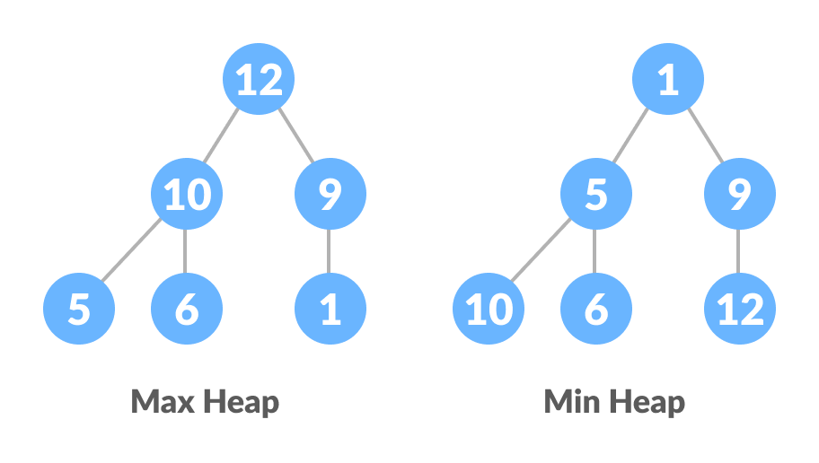
Heap Data Structure
Heap is a special tree-based data structure. A binary tree us said to follow a heap data structure if
It is a complete binary tree
All nodes in the tree follow the property that they are greater than their children.i.e the largest element is at the root and both its children and smaller than the root and so on. Such a heap is called a max-heap. If instead, all nodes are smaller than their children, it is called a min-heap
.

Slide 4
1 Removal = 1 Addition
Every time we do a DeleteMax, the heap gets smaller by one node, and we have one more node to store
Store the data at the end of the heap array
Not "in the heap" but it is in the heap array
6
value
6
5
4
2
7
5
4
index
1
2
3
4
5
6
7 8
2
7
N = 4

Slide 5
Repeated DeleteMax
5
5
2
4
6
7
2
4
1
2
3
4
5
6
7 8
6
7
N = 3
4
4
2
5
6
7
2
5
1
2
3
4
5
6
7 8
6
7
N = 2

Slide 6
Heap Sort is In-place
After all the DeleteMaxs, the heap is gone but the array is full and is in sorted order
2
value
2
4
5
6
7
4
5
index
1
2
3
4
5
6
7
8
6
7
N = 0

Slide 7
Heapsort: Analysis
Running time
time to build max-heap is O(N)
time for N DeleteMax operations is N O(log N)
total time is O(N log N)
Can also show that running time is Ω(N log N) for some inputs,
so worst case is Θ(N log N)
Average case running time is also O(N log N)
Heapsort is in-place but not stable (why?)

Slide 8
Working of Heap Sort
Since the tree satisfies Max-Heap property, then the largest item is stored at the root node.
Swap: Remove the root element and put at the end of the array (nth position) Put the last item of the tree (heap) at the vacant place.
Remove: Reduce the size of the heap by 1.
Heapify: Heapify the root element again so that we have the highest element at root.
The process is repeated until all the items of the list are sorted.

Slide 9
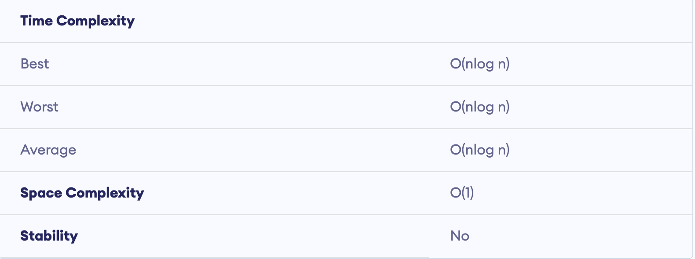
Properties

Slide 10
Properties
Systems concerned with security and embedded systems such as Linux Kernel use Heap Sort because of the O(n log n) upper bound on Heapsort's running time and constant O(1) upper bound on its auxiliary storage.
Its underlying data structure, heap, can be efficiently used if we want to extract the smallest (or largest) from the list of items without the overhead of keeping the remaining items in the sorted order. For e.g Priority Queues.

Slide 11
Any Question?
Thank You!!!

